Slide 1

Pictet Case Study – Which country will you invest in?
Marco Pistis

Slide 2
Summary
Tasks
Data preparation
ESG framework
ESG methodology
ESG results
Sovereign bond spread forecasting - VAR
Sovereign bond spread forecasting – RNN
Deployment on the cloud

Slide 3
Tasks
Imaging you have CHF 10 million and you want to invest in sovereign bonds: which country would you invest in?
Task 1: Construct a country-level ESG rating using World Bank data.
Task 2: Build a model to predict the sovereign bond spreads with the data collected in the previous step.

Slide 4
Data preparation
27 selected indicators downloaded through the World Bank API from the ESG and the Millennium Development databases
Selection based on relevance and country coverage (52 emerging economies, yearly data for the period 2010-2020)
Missing values between observations have been imputed using linear interpolation for 5 period max
After imputation, countries with more than 33% of missing values across indicators have been removed from sample (e.g., Taiwan)

Slide 5
ESG framework (1)
Environment
Social
Governance
Carbon emissions
Health
Quality of institutions
Climate vulnerability
Education
Political stability
Nature conservation
Living standards
Freedom of speech

Slide 6
ESG framework (2)
Environmental factor | Social factor | Governance factor
CO2 emissions per capita | Infant mortality, life expectancy | Corruption
Depletion of natural resources (%) | Children undernourishment rate, people under poverty line | Rule of law
Exposure to pm 2.5 | Access to electricity, access to internet | Regulatory quality
Renewable energy consumption (%) | Vulnerable employment, unemployment | Government effectiveness
Terrestrial protected areas, Marine protected areas | Average school years, school enrollment rates corrected for gender parity | Voice and accountability
Forest area (%) | Gender equality, women in parliament | Political stability

Slide 7
ESG methodology
All indicators have been normalized to a 0-1 scale.
Each ESG factor's score is the average of the indicators scores belonging to that factor.
The overall ESG score is the average of the 3 factors scores.
N.B. The reference period considered to pick the min-max values used in the normalization process is the entire time series sample (i.e., 2010-2020). This ensures that scores are comparable overtime.

Slide 8
Limitations
For the sake of simplicity, only few representative indicators have been selected for each ESG area
Macroeconomic time series for emerging economies can be inaccurate and often present many missing values, therefore impacting also the quality of imputed data

Slide 9
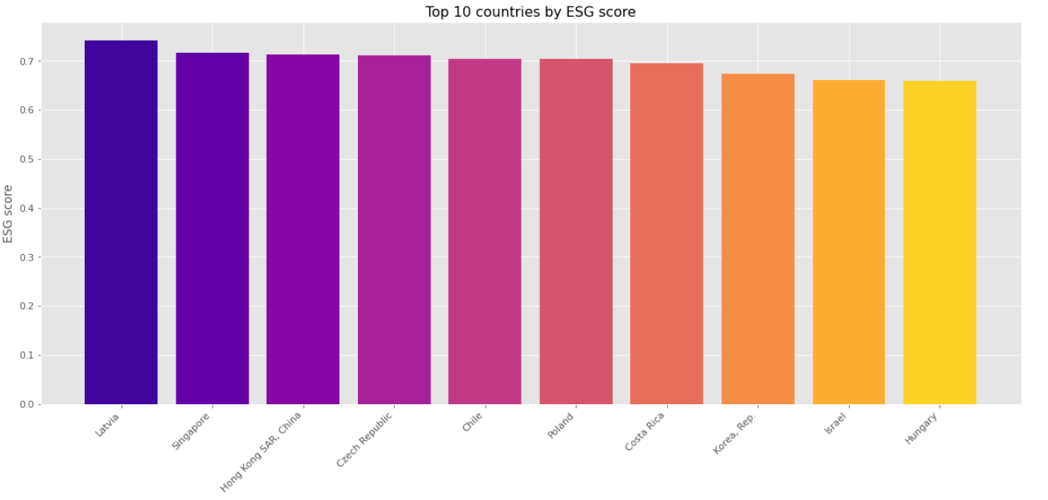
Top 10 countries by ESG scores

Slide 10
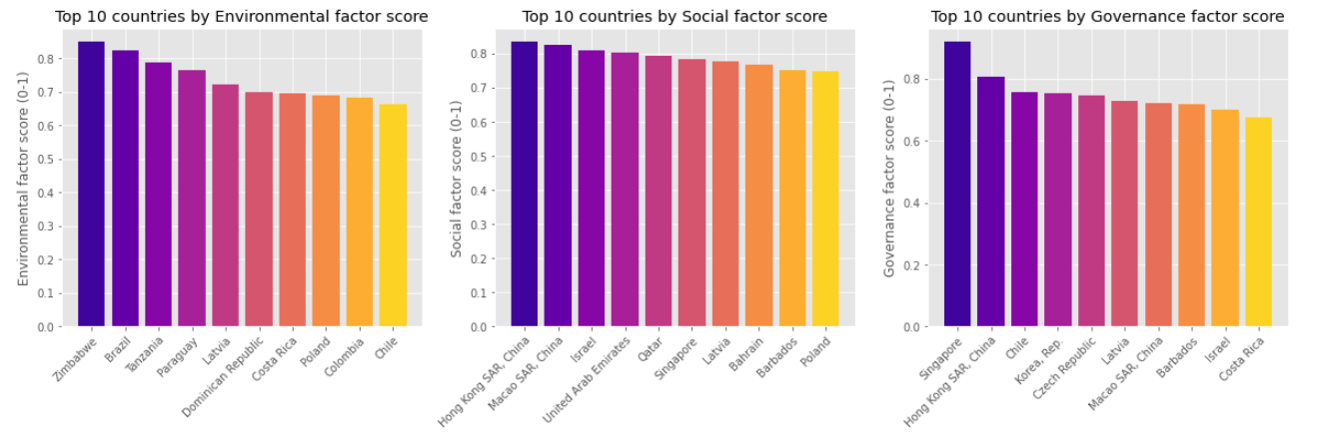
Top 10 by ESG factors

Slide 11
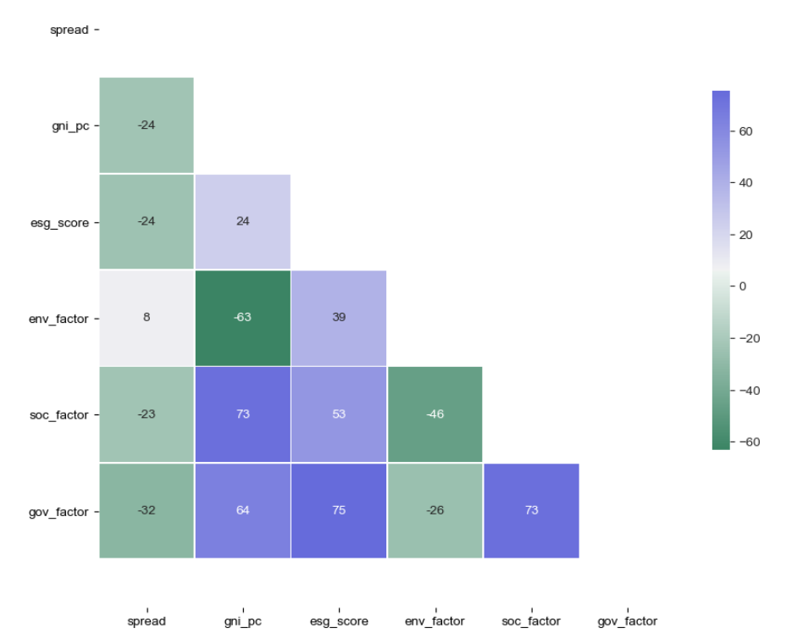
ESG score vs GNI vs spread (1)

Slide 12
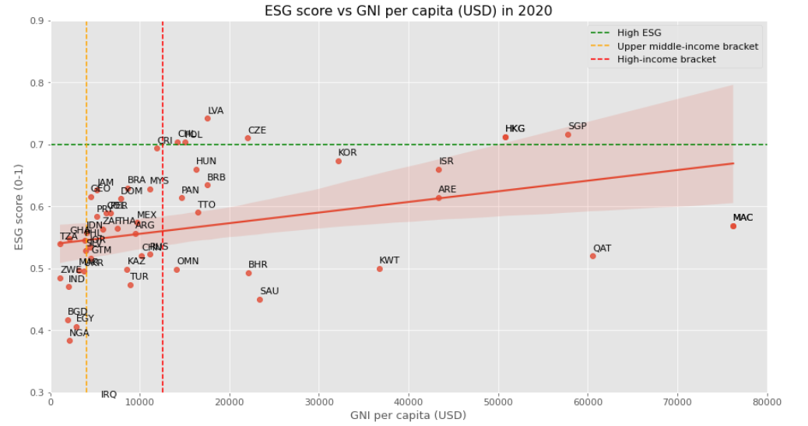
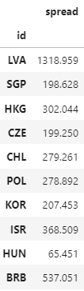
ESG score vs GNI vs spread (2)
Average spread in 2020

Slide 13
Data preparation for forecasting
The forecasting exercise consists in using the ESG data constructed so far to predict the value of the sovereign bond spread
Frequency of sovereign bond data is monthly, so the ESG data has been transformed from yearly to monthly base imputing new missing values via polynomial interpolation
Time series used for the models are very short (just above 100 observations) so the resulting performances of the estimated models are significantly (negatively) affected
For simplicity, the models have been estimated only for the country chosen for the investment (Singapore)

Slide 14
Forecasting – VAR model (1)
Vector Autoregression (VAR) is a standard econometric model used to analyze the relationships and forecast multiple time series
The idea is to use lags (t-h) of the 3 ESG pillars + lags (t-h) of the spread variable to predict the value of the spread at time (t)
A key requirement when working with this model is the stationarity of the time series. For this reason, both target and features have been log-diff

Slide 15
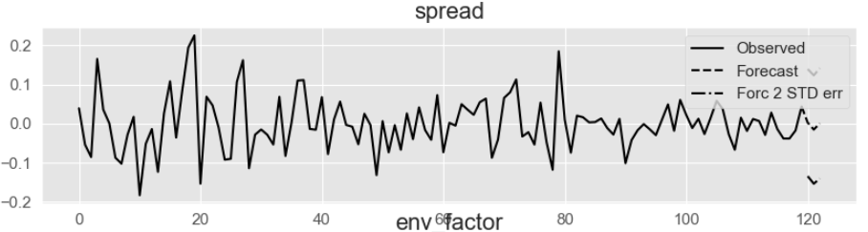
Forecasting – VAR model (2)
A VAR(3) with 3 autoregressive lags has been run
The VAR model can be used to calculate the optimal h-step ahead forecast in terms of mean-squared error. The forecasting horizon chosen here is 3 months.
The performance of the model can be assessed using RMSE: 0.039

Slide 16
Forecasting – RNN model (1)
RNN models are a common deep learning model used for prediction tasks thanks to its sequential “memory”
In this case, the model is univariate (only the target variable is used) and the data has been normalized (not log-differenced)
Instead of running a one-time forecast, the model has been estimated on a training set made of data from the period 2010-2017 and backtested on a test set constituted by 2018-2020 observations
The RNN model uses 6-months sequences to predict the next element in the sequence and has a forecasting horizon of 3 months

Slide 17
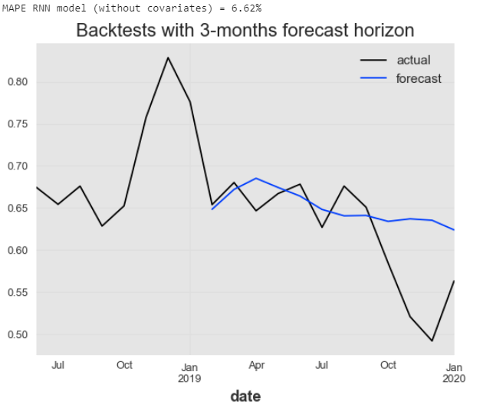
Forecasting – RNN model (2)
The performance of the model can be assessed with the mean absolute percentage error (MAPE): 6.62%
Despite the comforting values of the MAPE, the model is probably overfitting

Slide 18
Deployment on the cloud
This ML pipeline can be deployed on a cloud service like AWS
The World Bank API can be connected to the Glue workflow so that the entire extraction, transformation and loading (ETL) data process can be moved to AWS Glue
Amazon SageMaker can then be used to host, build, retrain, and deploy ML models at scale

